Slide 1
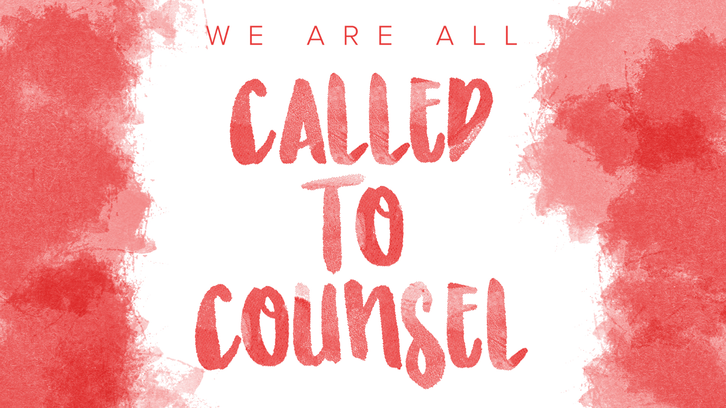

Slide 2
A Full Journey Perspective on Conflict Resolution
Conflict Resolution Track; Session One
Brad Hambrick

Slide 3
What is Conflict Resolution?
“Resolved” is a counseling word that sounds substantive but often means nothing.
We will use the image of journey.
A journey from an old, comfortable normal to a new, satisfying normal.
That is how we are using “resolved” to describe conflict.

Slide 4
Ezra 3:10b-13a
“…And all the people shouted with a great shout when they praised the Lord, because the foundation of the house of the Lord was laid. But many of the priests and Levites who had seen the first house, wept with a loud voice when they saw the foundation of this house being laid, though many shouted aloud for joy, so that the people could not distinguish the sound of the joyful shout from the sound of the people’s weeping…”

Slide 5
Stepping into Relational Chaos
First appointments often feel like being in a cash booth with money flying everywhere and we’re not sure what to grab.
This track is meant to help you be more strategic in counseling cases involving conflict resolution rather than hoping the counselee(s) auto-structure their case for you.

Slide 6
The “Journey” of Our Track i
Before Counseling Begins
A Full Journey Perspective (Hambrick)
Whole Person Care (Broom)
During Counseling Sessions
3. Perspective Taking in Conflict (Pierre)
A Process for Navigating Conflict (Broom)
Forgiveness: A Pivotal Point in the Story (Hambrick)

Slide 7
The “Journey” of Our Track II
Living After “Resolved”
6. The Unpleasant Side of Rom. 12:18 (Wilson)
Through the Counselor’s Eyes
7. The Redemptive Value of Conflict Done Well (Team Testimonies)
8. The Experience of the Counselor while Counseling Conflict (Team Panel Discussion)

Slide 8
The Experience of Counseling
Track Outlines
Counseling Cases
Clear
Linear
Compassionate
Redemptive
Matthew 7:3-5
This is why we ENJOY coming to conferences.
Muddy
Staccato
Narratively messy
Competitive
Philippians 4:2-3
This is why we NEED to come to conferences.

Slide 9
Case Study One: Maria and Evelyn (Introduction and Overview)

Slide 10
Case Study Two: Desmond, DJ, and Family (Introduction and Overview)

Slide 11
Reflective Questions
Who would you most likely be counseling (i.e., one individual or the group)?
If you had your choice, would you work with specific individual(s) or the group?
What would your most natural role be: friend, pastor, small group leader, elder, formal counselor, etc.?
What would your markers of success be to identify progress?
How much would you feel compelled to make “resolved” look like the “old normal” versus helping these individuals find a satisfying “new normal”?

Slide 12
Conflict Resolution: A Group Project
Put yourself in each character’s shoes. How does the definition of “success” change?
How do you, as the counselor, begin to harmonize these various definitions of success for counseling?
Reality: The more people who are in the room (literally or consequentially), the more complicated counseling becomes (multiplication, not addition).
This is why conflict resolution counseling can feel so difficult; not because the answer is complex, but because the journey has so many obstacles.

